Slide 1


<Eng Wei Hang>
<01/09/2024>

Slide 2
Outline
Executive Summary
Introduction
Methodology
Results
Conclusion

Slide 3
Executive Summary
Summary of methodologies
Business understanding and Analytic approach
Data collection and preparation with SpaceX API and Web Scrapping
Data undertanding using EDA, data cleansing, wrangling and interactive visualization
Modeling & Evaluation
Summary of all results
Exploratory Data Analysis outcomes
Interactive visual analytics and dashboard
Predictive Analysis (Classification)
Stakeholders presentation

Slide 4
Introduction
Project background and context
As a Data Scientist in SPACE Y (a new spaceship company) my job is to study the successful
landing outcome of a Space X Falcon 9 rocket and to estimate the cost of each launch
Problems you want to find answers
Understand how Space X Falcon 9 works through data
Predict if the Space X Falcon 9 first stage will land successfully
Determine the cost of a launch
Which the information to help Business function to build a innovation strategy for SPACE Y to
compete against SpaceX

Slide 5

Section 1
5

Slide 6
Methodology
Executive Summary
Data collection methodology:
Data was collected using :
Space X API : https://api.spacexdata.com/v4/launches/past
Web Scraping : https://en.wikipedia.org/w/index.php?title=List_of_Falcon_9_and_Falcon_Heavy_launc hes&oldid=1027686922
Perform data wrangling
Data was processed by exploratory Data Analysis to determine Training Labels
Perform exploratory data analysis (EDA) using visualization and SQL
Perform interactive visual analytics using Folium and Plotly Dash
6

Slide 7
Methodology
Executive Summary
Perform predictive analysis using classification models
Split the data into training testing data
Train different classification models (SVM, Classification Trees, and Logistic Regression)
Find the best method using hyperparameter grid search
Modeling & Evaluation
7

Slide 8
Data Collection
Describe how data sets were collected.
Data Collection using Space X API : https://api.spacexdata.com/v4/rockets/
Request and parse the SpaceX launch data using the GET request
Filter the dataframe to only include Falcon 9 launches
Data wrangling : Dealing with Missing Values¶
Data Collection using Web Scraping : https://en.wikipedia.org/w/index.php?title=List_of_Falcon_9_and_Falcon_Heavy_launc hes&oldid=1027686922
Request the Falcon9 Launch Wiki page from its URL
Extract all column/variable names from the HTML table header
Create a data frame by parsing the launch HTML tables
8

Slide 9
Data Collection – SpaceX API
Data is requested from url and parsed as DataFrame
We filter the data to have only Falcon9 launches
We perform data cleansing and
formatting
1. Request and parse the SpaceX launch data using the GET request
2. Filter the dataframe to only include Falcon 9 launches
GitHub notebook URL : jupyter-labs-spacex-data-collection-api.ipynb
3. Dealing with Missing Values¶
9

Slide 10
Data Collection - Scraping
Data is requested from Wikipedia link
We extract all columnnames from the HTML table header using Beautifulsoup library
Create a data frame by parsing the launch HTML tables
GitHub note URL : jupyter-labs-webscraping-last.ipynb
1. Request the Falcon9 Launch Wiki page from its URL
2. Extract all column/variable names from the HTML table
header
3. Create a data frame by parsing the launch HTML tables
10

Slide 11
Data Wrangling
We calculate the number of launches on each site
We calculate the number and occurrence of
each orbit
We calculate the number and occurrence of mission outcome per orbit type
We create a landing outcome label from Outcome column
calculate the number of launches
on each site
calculate the number and
occurrence of each orbit
calculate the number and occurrence of mission outcome per orbit type
GitHub URL source : labs-jupyter-spacex-Data wrangling.ipynb
create a landing outcome label from Outcome column
11

Slide 12
EDA with SQL
The SQL queries you performed
%sql SELECT DISTINCT(Launch_Site) FROM SPACEXTBL
%sql SELECT Launch_Site FROM SPACEXTBL WHERE Launch_Site LIKE "CCA%" LIMIT 5
%sql SELECT Customer, SUM(PAYLOAD_MASS KG_) AS TOTAL_PAYLOAD_MASS_KG FROM SPACEXTBL WHERE Customer = 'NASA (CRS)'
%sql SELECT Booster_Version, AVG(PAYLOAD_MASS KG_) AS AVG_PAYLOAD_MASS_KG FROM SPACEXTBL WHERE Booster_Version = 'F9 v1.1'
%sql SELECT "Date","Landing _Outcome", MIN("Date") FROM SPACEXTBL WHERE "Landing _Outcome" LIKE "%ground pad%"
%sql SELECT Booster_Version, PAYLOAD_MASS KG_, "Landing _Outcome" FROM SPACEXTBL WHERE "Landing _Outcome" LIKE "%success%drone ship%" AND (PAYLOAD_MASS KG_ BETWEEN 4000 AND 6000)
%sql SELECT Mission_Outcome, COUNT(Mission_Outcome) AS TOTAL_SUCCESS_FAILURE FROM SPACEXTBL GROUP BY Mission_Outcome
%sql SELECT Booster_Version, PAYLOAD_MASS KG_ FROM SPACEXTBL WHERE PAYLOAD_MASS KG_ = (SELECT MAX(PAYLOAD_MASS KG_) FROM SPACEXTBL)
%sql SELECT "Date", substr("Date", 4, 2), "Landing _Outcome", Booster_Version, Launch_Site FROM SPACEXTBL WHERE "Landing _Outcome" LIKE "%failure%" AND substr(Date,7,4)='2015'
%sql SELECT "Date", "Landing _Outcome", COUNT("Landing _Outcome") AS SLO FROM SPACEXTBL WHERE "Landing _Outcome" LIKE "%Success%" GROUP BY ("Date" BETWEEN '04-06-2010' AND '20-03-2017') ORDER BY SLO DESC
GitHub URL of completed EDA with SQL notebook : jupyter-labs-eda-sql-coursera_sqllite.ipynb
12

Slide 13
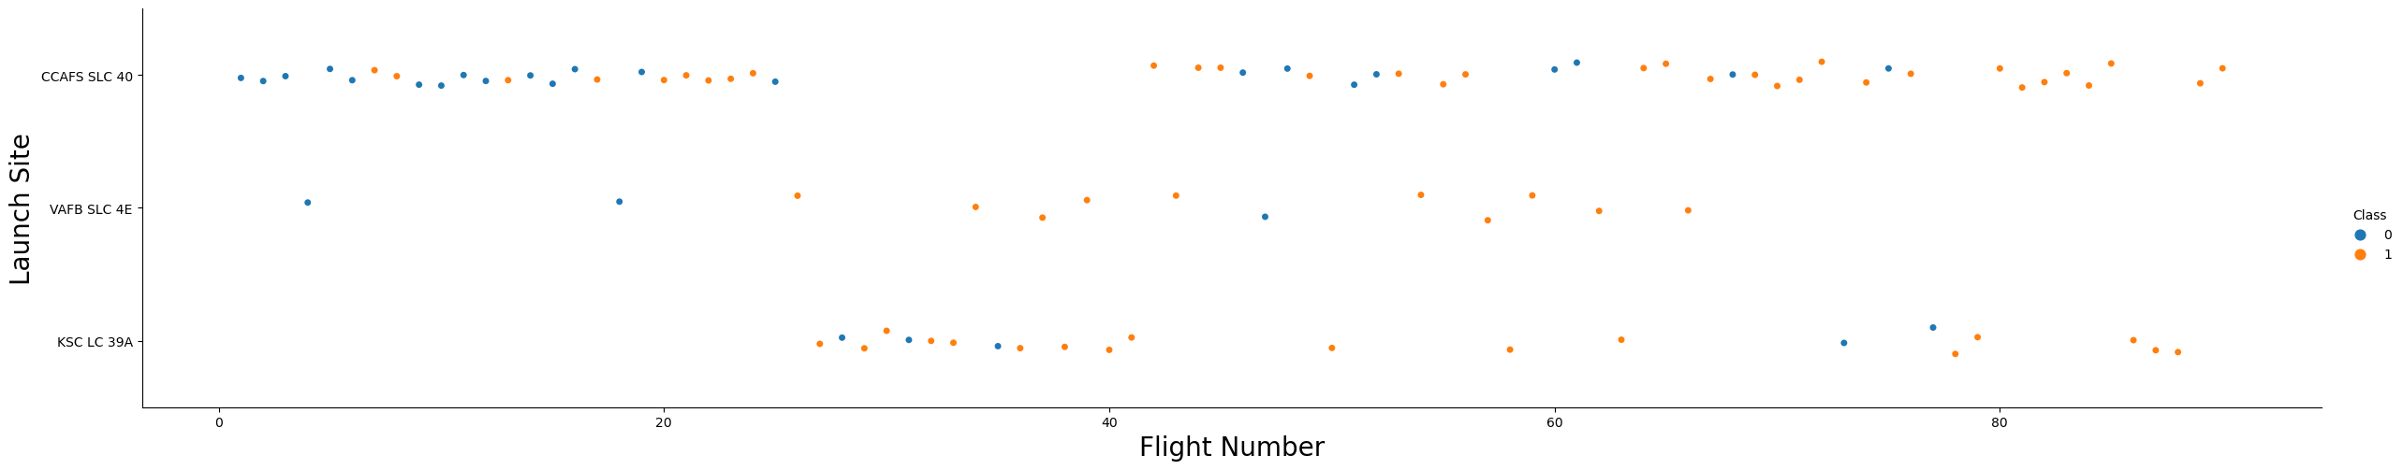
EDA with Data Visualization
We perform EDA to evaluate the relationship between the different features which behavior would affect the launch outcome
We use scatter plot & barplot to display the results

Slide 14
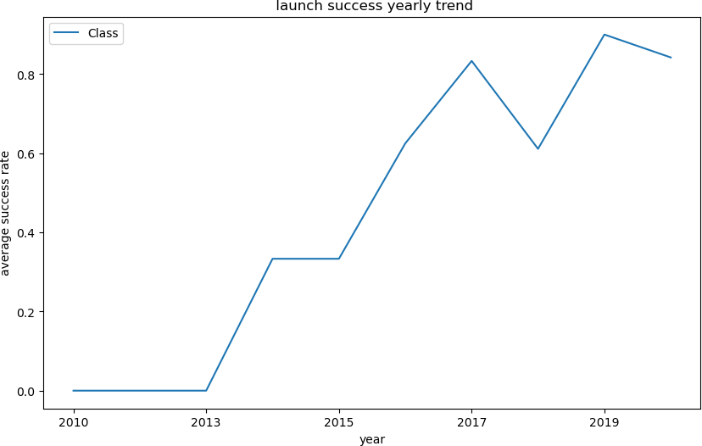
EDA with Data Visualization
Bar Chart : we can observe that the success rate since 2013 kept Increasing till 2020
Finally, we perform one-hot encoding To format the features that will be used in success prediction
GitHub URL of EDA with data visualization notebook :jupyter-labs-eda-dataviz.ipynb

Slide 15
Build an Interactive Map with Folium
Mark all launch sites on a map
Use Folium.Circle() to create a circle for each launch site on the the map based on its latitude and longitude
Use Folium.map.Marker() to create a marker for each launch site on the the map on its latitude and longitude
Mark the success/failed launches for each site on the map
Here we use MarkerCluster() to simply map containing many markers having the same coordinate the
we label them as green/red if success/failed
Calculate the distances between a launch site to its proximities
In this section we use MousePosition to get the coordinate on the map
folium.PolyLine() to draw a line between the the marker to the launch site, city, railway, highway
GitHub URL of your completed interactive map with Folium map : lab_jupyter_launch_site_location.ipynb

Slide 16
Build a Dashboard with Plotly Dash
Plots/graphs and interactions added to a dashboard :
Pie chart Callback function to show the total successful launches count for all sites
Input : All/sites or a specific launch site
Output : success/failed launch outcome
Scatter chart Callback function to show the correlation between payload and launch success
inputs : All/sites or a specific launch Site and Payload
Output : success/failed launch outcome
Slider object to select a playload
GitHub URL of the completed Plotly Dash lab:spacex_dash_app.py

Slide 17
Predictive Analysis (Classification)
The best way to perform classification model :
Use Hyperparameter to find the best fitting parameter
Try different classification algorithms : Logistic Regression, SVM, KNN and Decision
Tree
Model development process :
Data preparation (Class splitting, Normalization )
Hyperparameter Setup with GridSearchCV
Training
& Prediction
Splitting data into train and test
Scoring and Evaluation
GitHub URL of predictive analysis lab:SpaceX_Machine Learning Prediction_Part_5.ipynb

Slide 18
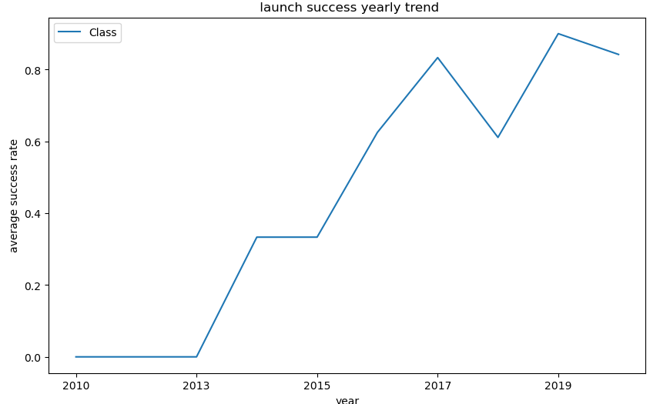
Results
Exploratory data analysis results :
We can observe that the success rate since 2013 kept increasing till 2020

Slide 19
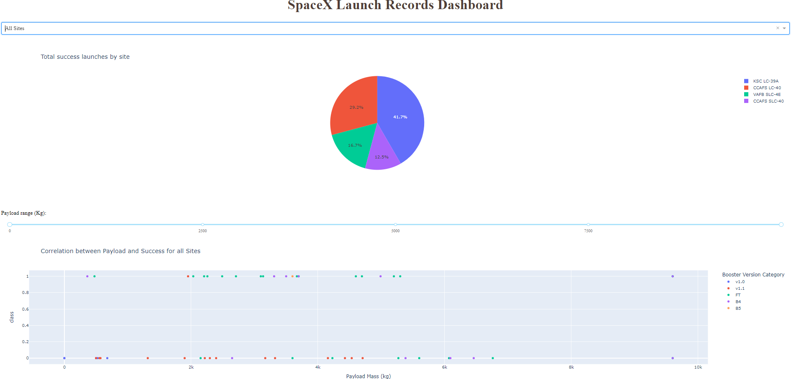
Results
Interactive analytics demo in screenshots :

Slide 20
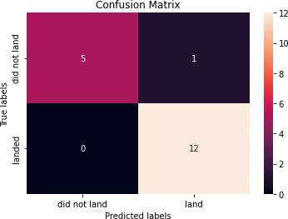
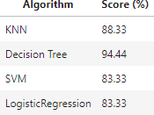
Results
Predictive analysis results :
Decision Tree looks to be the best predictive model with Landing accuracy : 88% and Test Accuracy : 94%

Slide 21

Section 2

Slide 22
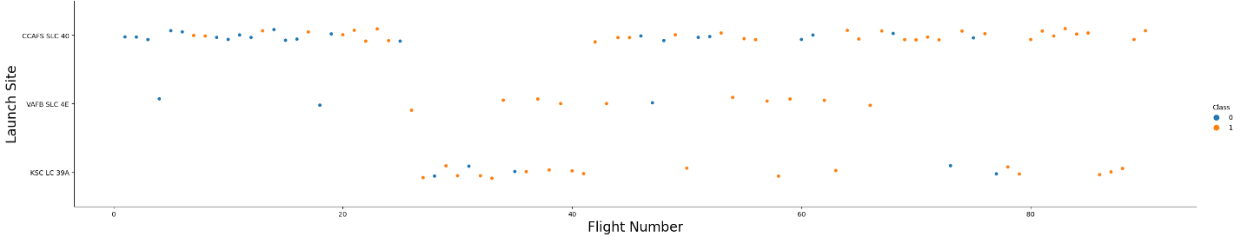
Flight Number vs. Launch Site
Show a scatter plot of Flight Number vs. Launch Site
We see that as the flight number increases, the first stage is more likely to land
successfully in each Launch Site

Slide 23
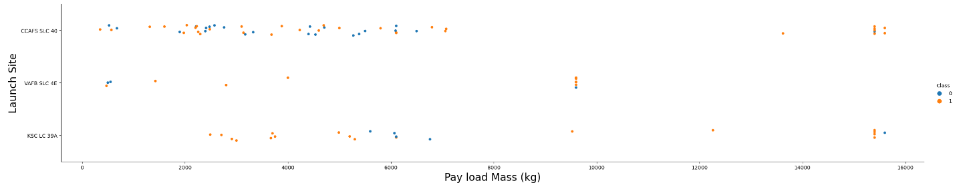
Payload vs. Launch Site
Scatter plot of Payload vs. Launch Site
We can observe Payload Vs. Launch Site scatter point chart you will find for the VAFB- SLC launch site there are no rockets launched for heavy payload mass(greater than 10000)

Slide 24
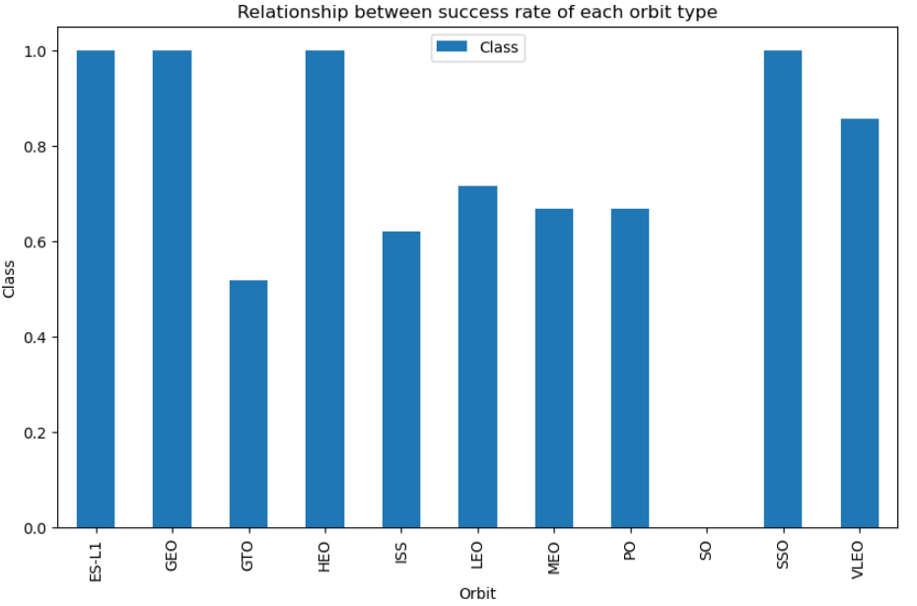
Success Rate vs. Orbit Type
A bar chart for the success
rate of each orbit type
Orbit ES-L1, GEO, HEO,
SSO have the high success
rate

Slide 25
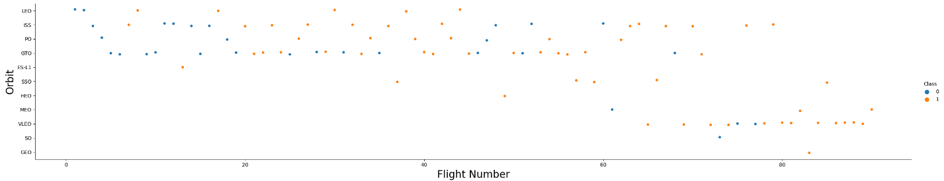
Flight Number vs. Orbit Type
Show a scatter point of Flight number vs. Orbit type
We can see that in the LEO orbit the Success appears related to the number of flights; on the other hand, there seems to be no relationship between flight number when in GTO orbit

Slide 26
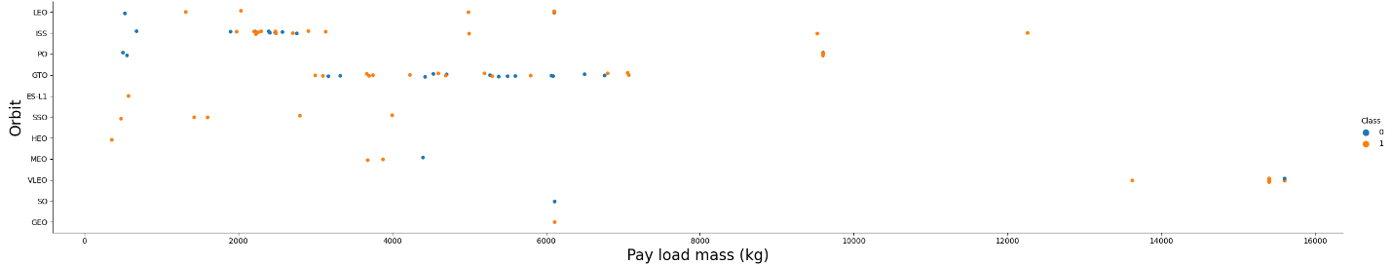
Payload vs. Orbit Type
Scatter point of payload vs. orbit type
With heavy payloads the successful landing or positive landing rate are more for Polar, LEO
and ISS.
However for GTO we cannot distinguish this well as both positive landing rate and negative landing(unsuccessful mission) are both there here.

Slide 27
Launch Success Yearly Trend
Line chart of yearly average
success rate
The success rate since 2013 kept increasing till 2020

Slide 28
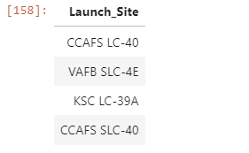
All Launch Site Names
Find the names of the unique launch sites
query result of name of the 4 unique sites

Slide 29
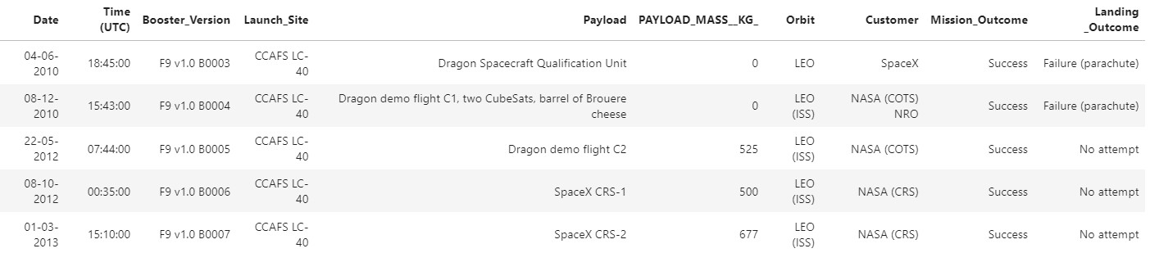
Launch Site Names Begin with 'CCA'
Find 5 records where launch sites begin with `CCA`

Slide 30
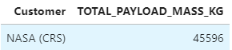
Total Payload Mass
Calculate the total payload carried by boosters from NASA
query result

Slide 31
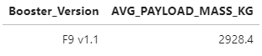
Average Payload Mass by F9 v1.1
The average payload mass carried by booster version F9 v1.1
Query result

Slide 32
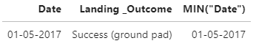
First Successful Ground Landing Date
Find the dates of the first successful landing outcome on ground pad
Query result

Slide 33
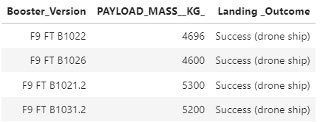
Successful Drone Ship Landing with Payload between 4000 and 6000
List the names of boosters which have successfully landed on drone ship
and had payload mass greater than 4000 but less than 6000
Query result

Slide 34
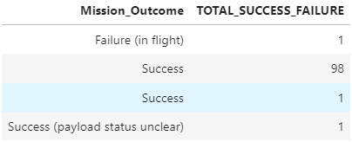
Total Number of Successful and Failure Mission Outcomes
Calculate the total number of successful and failure mission outcomes
Query result

Slide 35
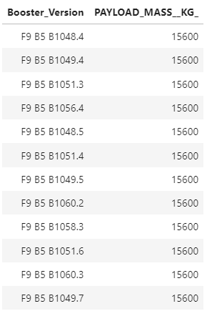
Boosters Carried Maximum Payload
List the names of the booster which have carried the maximum payload
mass
Query result on the right

Slide 36
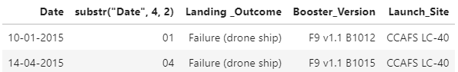
2015 Launch Records
List the failed landing_outcomes in drone ship, their booster versions,
and launch site names for in year 2015
Query result

Slide 37
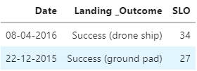
Rank Landing Outcomes Between 2010-06-04 and 2017-03-20
Rank the count of landing outcomes (such as Failure (drone ship) or Success (ground pad)) between the date 2010-06-04 and 2017-03-20, in descending order
Query result :

Slide 38

Section 3

Slide 39
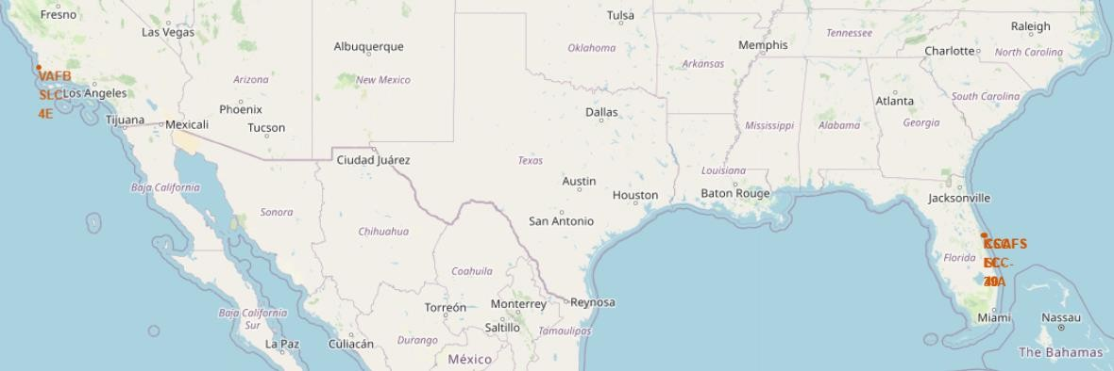
All launch sites on a map
VAFB SLC-4E is located in California
CCAFS LC-40, CCAFS SLC-40, KSC LC-39A are located in Florida
39

Slide 40
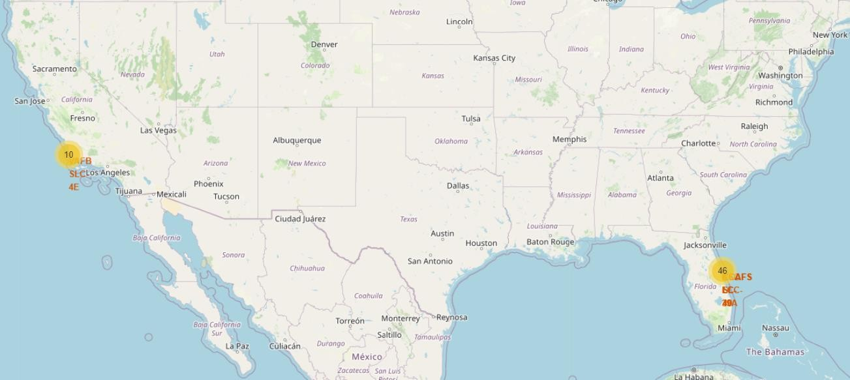
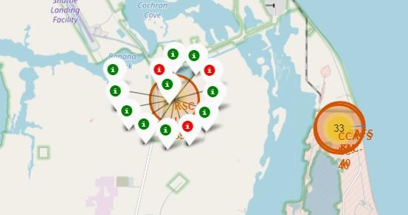
Mark of success/failed launches for each site on the map
If we zoom in we can identify which launch sites have relatively high success rates.
Total of success/failed launches for each site are marked as green/red

Slide 41
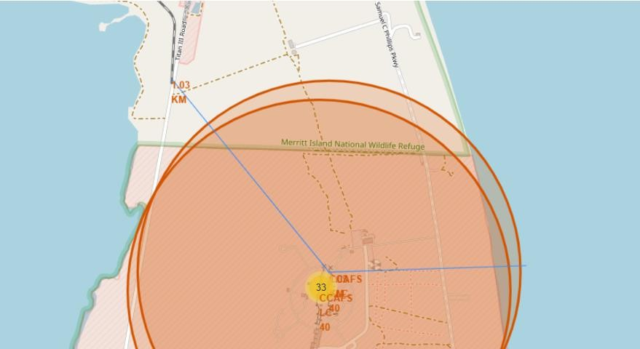
The distances between a launch site to its proximities
Line between a launch site and coastline, railway to illustrate the finding.
Similar approach for highway and city map

Slide 42

Section 4

Slide 43
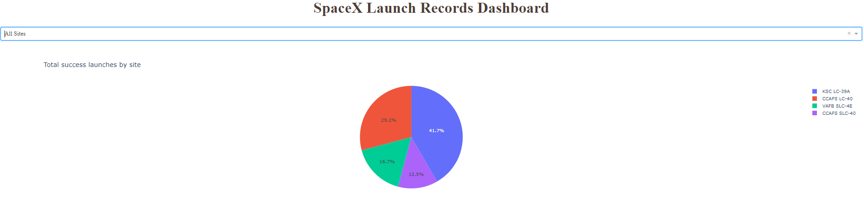
The screenshot of launch success count for all sites, in a piechart
Total success launch by site, we can see that KSC LC-39A has the best rate of success of 41.7%

Slide 44
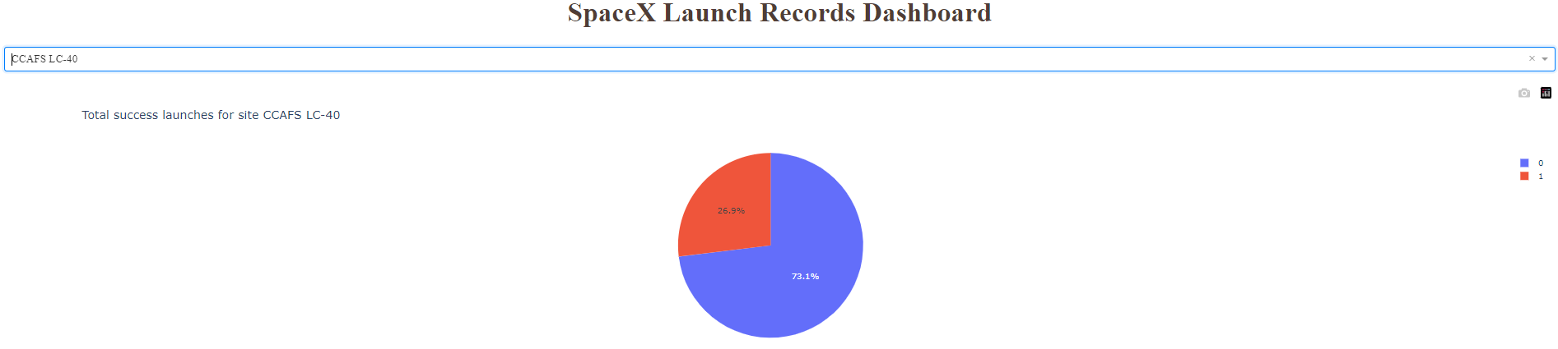
The screenshot of the piechart for the launch site with highest launch success ratio
Total success launches for site CCAFS LC-40

Slide 45
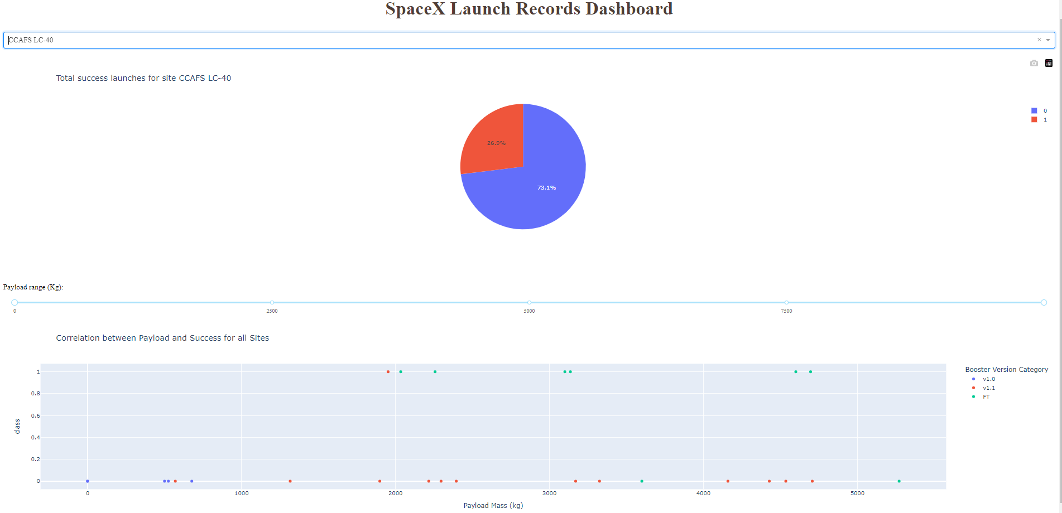
Payload vs. Launch Outcome scatter plot for all sites
The range slider allows to select different payloads which can impact the success outcome according to the payload value
45

Slide 46

Section 5

Slide 47
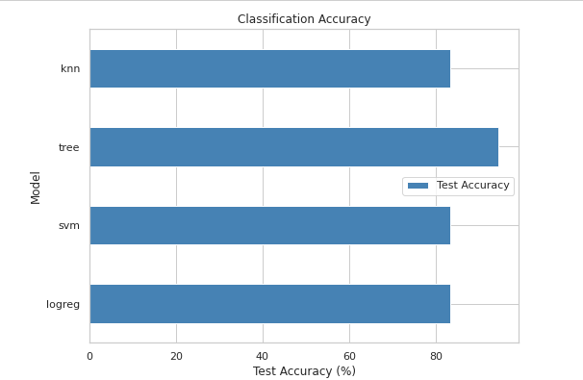
Classification Accuracy
Built model accuracy for all built
classification models, in a bar chart
The decision Tree has highest
accuracy of 94.44%

Slide 48
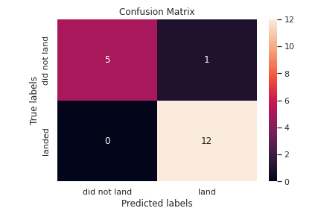
Confusion Matrix
The confusion matrix of the best performing model – Decision Tree
We can observe that TP = 12 High number and we have TN = 5 the low one
But as shown in the heatmap reflets the FP, FN values are very closed which leads to stable model
We can calculate the score :
Precision = 12/(12 + 1) = 0,92 and Recall = 12(12 + 0) = 1
Score = 2*(prc*rec)/(prc + rec) = 2*(0.92)/1.92 = 0.96
The score is 96% is closed to 94% predicted by the model

Slide 49
Conclusion
Launch success rate started to increase in 2013 till 2020
The best launch site is KSC LC 39A of 41.7%
Orbit ES-L1, GEO, HEO, SSO have the high success rate
The decision Tree has highest accuracy of 94.44%

Slide 50


